Slide 1
THE LIFE OF CHRIST
PART 31

Slide 2
Matthew 7:7 " Ask, and it will be given to you; seek, and you will find; knock, and it will be opened to you. ⁸ "For everyone who asks receives, and he who seeks finds, and to him who knocks it will be opened.

Slide 3
Luke 18:1 Then He spoke a parable to them, that men always ought to pray and not lose heart, ² saying: "There was in a certain city a judge who did not fear God nor regard man. ³ "Now there was a widow in that city; and she came to him, saying, 'Get justice for me from my adversary.' ⁴ "And he would not for a while; but afterward he said within himself, 'Though I do not fear God nor regard man, ⁵ 'yet because this widow troubles me I will avenge her, lest by her continual coming she weary me.' " ⁶ Then the Lord said, "Hear what the unjust judge said. ⁷ "And shall God not avenge His own elect who cry out day and night to Him, though He bears long with them? ⁸ "I tell you that He will avenge them speedily. Nevertheless, when the Son of Man comes, will He really find faith on the earth?"

Slide 4
Romans 8:28 And we know that all things work together for good to those who love God, to those who are the called according to His purpose.

Slide 5
James 5:16 The effective, fervent prayer of a righteous man avails much.

Slide 6
Matthew 7:9 "Or what man is there among you who, if his son asks for bread, will give him a stone? ¹⁰ "Or if he asks for a fish, will he give him a serpent? ¹¹ "If you then, being evil, know how to give good gifts to your children, how much more will your Father who is in heaven give good things to those who ask Him!

Slide 7
1 John 5:14 Now this is the confidence that we have in Him, that if we ask anything according to His will, He hears us. ¹⁵ And if we know that He hears us, whatever we ask, we know that we have the petitions that we have asked of Him.

Slide 8
James 1:5 If any of you lacks wisdom, let him ask of God, who gives to all liberally and without reproach, and it will be given to him. ⁶ But let him ask in faith, with no doubting, for he who doubts is like a wave of the sea driven and tossed by the wind. ⁷ For let not that man suppose that he will receive anything from the Lord; ⁸ he is a double-minded man, unstable in all his ways.

Slide 9
1 Thessalonians 5:17 pray without ceasing,

Slide 10
Luke 18:9 Also He spoke this parable to some who trusted in themselves that they were righteous, and despised others: ¹⁰ "Two men went up to the temple to pray, one a Pharisee and the other a tax collector. ¹¹ "The Pharisee stood and prayed thus with himself, 'God, I thank You that I am not like other men -- extortioners, unjust, adulterers, or even as this tax collector. ¹² 'I fast twice a week; I give tithes of all that I possess.' ¹³ "And the tax collector, standing afar off, would not so much as raise his eyes to heaven, but beat his breast, saying, 'God, be merciful to me a sinner!' ¹⁴ "I tell you, this man went down to his house justified rather than the other; for everyone who exalts himself will be humbled, and he who humbles himself will be exalted."

Slide 11
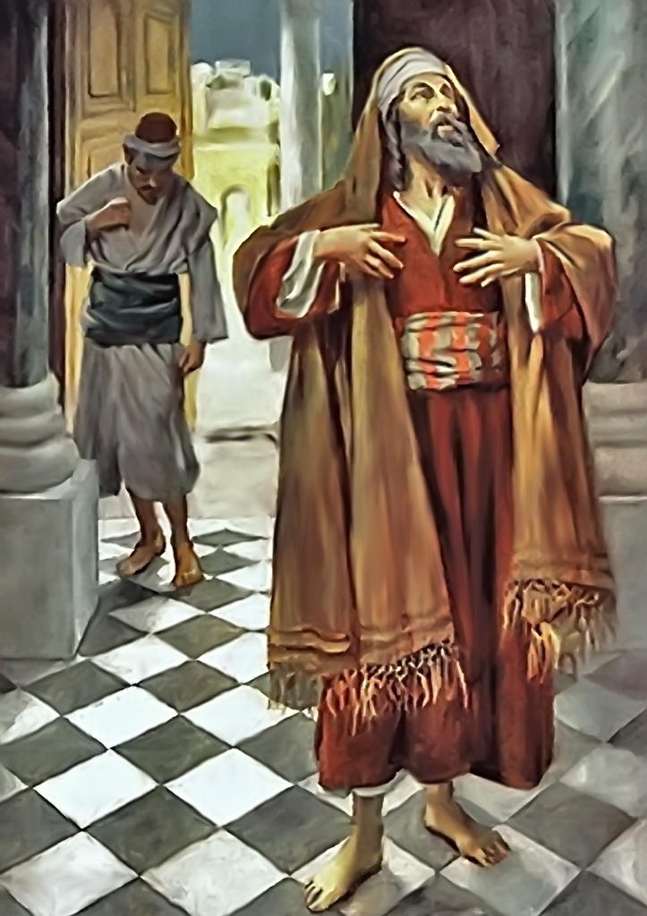

Slide 12


Slide 13
Exodus 14:15 And the LORD said to Moses, "Why do you cry to Me? Tell the children of Israel to go forward. ¹⁶ "But lift up your rod, and stretch out your hand over the sea and divide it. And the children of Israel shall go on dry ground through the midst of the sea. ¹⁷ "And I indeed will harden the hearts of the Egyptians, and they shall follow them. So I will gain honor over Pharaoh and over all his army, his chariots, and his horsemen. ¹⁸ "Then the Egyptians shall know that I am the LORD, when I have gained honor for Myself over Pharaoh, his chariots, and his horsemen."

Slide 14
Matthew 7:12 "Therefore, whatever you want men to do to you, do also to them, for this is the Law and the Prophets.

Slide 15
1 Corinthians 13:4 Love suffers long and is kind; love does not envy; love does not parade itself, is not puffed up; ⁵ does not behave rudely, does not seek its own, is not provoked, thinks no evil; ⁶ does not rejoice in iniquity, but rejoices in the truth; ⁷ bears all things, believes all things, hopes all things, endures all things. ⁸ Love never fails.

Slide 16
Matthew 22:36 "Teacher, which is the great commandment in the law?" ³⁷ Jesus said to him, " 'You shall love the LORD your God with all your heart, with all your soul, and with all your mind.' ³⁸ "This is the first and great commandment. ³⁹ "And the second is like it: 'You shall love your neighbor as yourself.' ⁴⁰ "On these two commandments hang all the Law and the Prophets."

Slide 17
Philippians 2:1 Therefore if there is any consolation in Christ, if any comfort of love, if any fellowship of the Spirit, if any affection and mercy, ² fulfill my joy by being like-minded, having the same love, being of one accord, of one mind. ³ Let nothing be done through selfish ambition or conceit, but in lowliness of mind let each esteem others better than himself. ⁴ Let each of you look out not only for his own interests, but also for the interests of others. ⁵ Let this mind be in you which was also in Christ Jesus,

Slide 18
Ephesians 5:22 Wives, submit to your own husbands, as to the Lord. ²³ For the husband is head of the wife, as also Christ is head of the church; and He is the Savior of the body. ²⁴ Therefore, just as the church is subject to Christ, so let the wives be to their own husbands in everything. ²⁵ Husbands, love your wives, just as Christ also loved the church and gave Himself for her, ²⁶ that He might sanctify and cleanse her with the washing of water by the word, ²⁷ that He might present her to Himself a glorious church, not having spot or wrinkle or any such thing, but that she should be holy and without blemish. ²⁸ So husbands ought to love their own wives as their own bodies; he who loves his wife loves himself. ²⁹ For no one ever hated his own flesh, but nourishes and cherishes it, just as the Lord does the church.

Slide 19
Ephesians 6:1 Children, obey your parents in the Lord, for this is right. ² "Honor your father and mother," which is the first commandment with promise: ³ "that it may be well with you and you may live long on the earth." ⁴ And you, fathers, do not provoke your children to wrath, but bring them up in the training and admonition of the Lord.

